Slide 1

KS3 Mathematics
D2 Finding the mode
Notes:
The aim of this unit is to teach pupils to:
Calculate statistics from data, using ICT as appropriate, finding the mode, mean, median and range
Material in this unit is linked the Framework’s supplement of examples pp256 –261.

Slide 2


Finding the mode
The mode or modal value in a set of data is the data value that appears the most often.
For example, the number of goals scored by the local football team in the last ten games is:
2,
2,
1,
1,
2,
2,
0,
0,
0,
0,
2,
2,
3,
3,
1,
1,
2,
2,
1.
1.
The modal score is 2.
Is it possible to have more than one modal value?
Yes
Is it possible to have no modal value?
Yes

Slide 3
Finding the mode
A dice was thrown ten times. These are the results:
What was the modal score?
3 is the modal score because it appears most often.

Slide 4
Finding the mode
The mode is the only average that can be used for categorical or non-numerical data.
For example, 30 pupils are asked how they usually travel to school. The results are shown in a frequency table.
Method of travel | Frequency
Bicycle | 6
On foot | 8
Car | 2
Bus | 6
Train | 3
What is the modal method of travel?
8
Most children travel on foot.
Travelling on foot is therefore the modal method of travel.
Notes:
Stress that the modal method will have the highest frequency.

Slide 5
Finding the mode from a bar chart
This bar chart shows the scores in a science test:
9
8
7
6
Number of pupils
5
4
3
2
1
0
1
2
3
4
5
6
7
8
9
10
Marks out of ten
What was the modal score?
6 is the modal score because it has the highest bar.
Notes:
This bar chart can be edited by double clicking on it in Normal view.

Slide 6
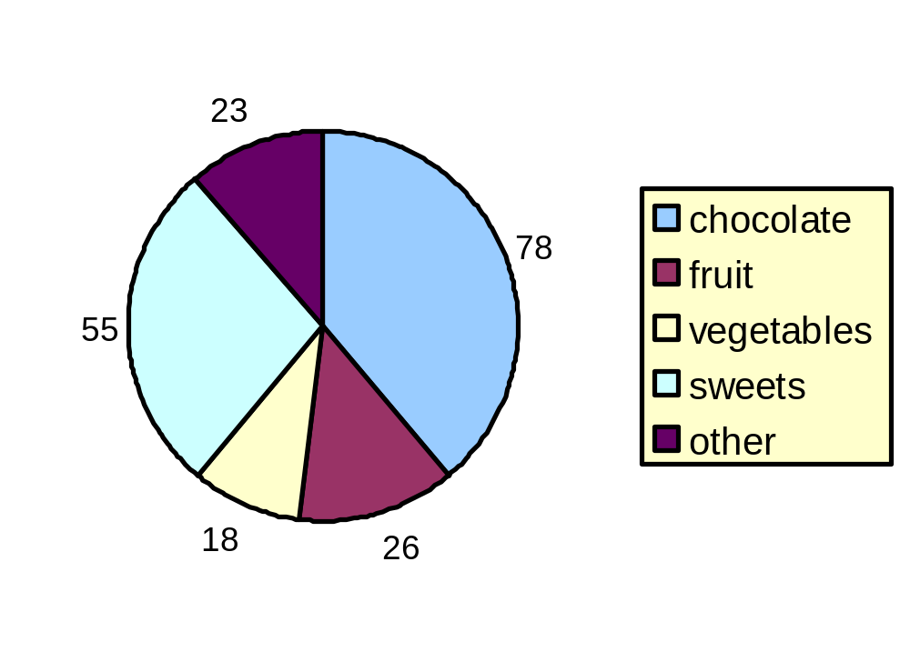
Finding the mode from a pie chart
This pie chart shows the favourite food of a sample of people:
What was the modal food type?
The biggest sector of the pie chart is for chocolate, so this is the modal food type.
Notes:
Ask pupils to tell you how many people were surveyed (200).
Ask pupils to tell you what percentage of people liked each type of food.

Slide 7
Finding the mode from a frequency table
This frequency table shows the frequency of different length words in a given paragraph of text.
Word length
1
2
3
4
5
6
7
8
9
10
Frequency
3
16
12
16
7
3
11
6
2
1
16
16
What was the modal word length?
We need to look for the word lengths that occur most frequently.
For this data there are two modal word lengths: 2 and 4.
Notes:
2 and 4 are the modal word lengths because they both appeared 16 times.

Slide 8
Finding the modal class for continuous data
This grouped frequency table shows the times 50 girls and 50 boys took to complete one lap around a race track.
Frequency
What is the modal class for the girls?
Time (minutes:seconds)
Boys
Girls
2:00 ≤ t < 2:15
3
1
What is the modal class for the boys?
2:15 ≤ t < 2:30
7
6
2:30 ≤ t < 2:45
11
10
What is the modal class for the pupils regardless of whether they are a boy or a girl?
2:45 ≤ t < 3:00
13
9
3:15 ≤ t < 3:30
8
12
3:30 ≤ t < 3:45
7
10
3:45 ≤ t < 4:00
1
2
Notes:
Establish that the modal class for the girls is 3:15 ≤ t < 3:30 and modal class for the boys is 2:45 ≤ t < 3:00.
To find the modal class for both boys and girls we must add the two frequencies in each row together. The modal class is 2:45 ≤ t < 3:00.

